Slide 1
AirBNB Reviews Sentiment Analysis (Natural Language Processing)
Daniel Yap

Slide 2
Dataset Source
Kaggle
https://www.kaggle.com/datasets/muhammadahmedansari/airbnb-dataset
6 columns
342,904 rows

Slide 3
Problems / Challenges
Analyze large dataset of reviews with different languages.
Difficulties in translating sentimental analysis results into actionable strategies in service quality improvements.

Slide 4
Objectives
Develop automated processes or tools to handle large data.
Implement a standardized sentiment scoring system to:
measure and track changes of customer satisfaction
facilitate data-driven decision-making
target service enhancements

Slide 5
Target Audience
AirBNB business owners
Non-AirBNB business owners

Slide 6
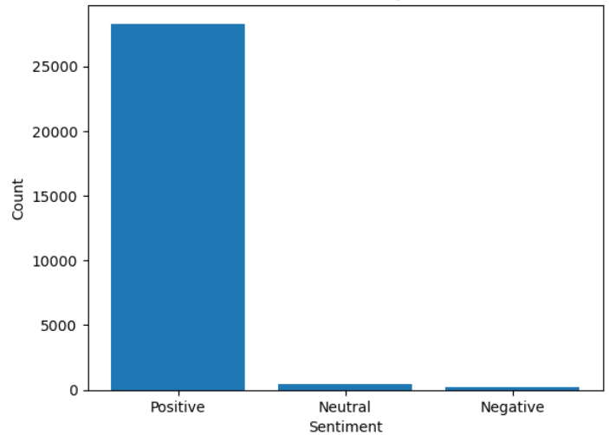

Findings
Figure 1. Sentiment Analysis

Slide 7
Model Evaluation
It helps businesses make informed decisions based on genuine customer feedback.
High accuracy prevents misinterpretation of sentiments which could lead to incorrect actions.

Slide 8
Reference
Tutorial: Quickstart — TextBlob 0.18.0.post0 documentation. (n.d.). https://textblob.readthedocs.io/en/dev/quickstart.html
Raza, M. R., Hussain, W., & Varol, A. (2022a). Performance analysis of deep approaches on airbnb sentiment reviews. 2022 10th International Symposium on Digital Forensics and Security (ISDFS). https://doi.org/10.1109/isdfs55398.2022.9800816

Slide 9
Thank you

Slide 10
Appendix

